Slide 1
Illumination Methods
Knights Who Say Ni Group Project 2:
Christopher McDaniel
Dean Morgan-Brown
Daniel Feuling

Slide 2
Different Illumination Methods
Ambient
Diffuse
Specular
Phong (combined)

Slide 3
Ambient
This is the general brightness level for a scene.
Produces a uniform ambient lighting for all objects.
Approximates the global diffuse reflections from the various lit objects.
For monochromatic lighting, the level for ambient light within a scene is given the intensity parameter I_{a}.
Reflections from ambient lighting are a simple form of diffuse reflection.
Notes:
With bullet point 4: Each surface in the scene is then illuminated with this background light.
With bullet point 5: They are independent of the viewing direction and the spatial orientation of a surface.

Slide 4
Diffuse
Diffuse light is scattered, and doesn’t leave sharp shadows.
Contrasts with ambient lighting, as diffuse lighting is dependant on the direction of incoming light rays

Slide 5
Specular
Specular lighting, like ambient and diffuse lighting, considers strength of light and direction of light rays.
Specular differs from the other two in that it also takes the position of the viewer into consideration.

Slide 6
Phong (combined)
Phong lighting is a combination of ambient, diffuse, and specular lighting.

Slide 7
Lighting calculation
In order to enable and disable lighting calculations in the OpenGL render pipeline, one must call glEnable and glDisable, respectively, with the argument GL_LIGHTING.
Ex: glEnable(GL_LIGHTING) and glDisable(GL_LIGHTING)

Slide 8
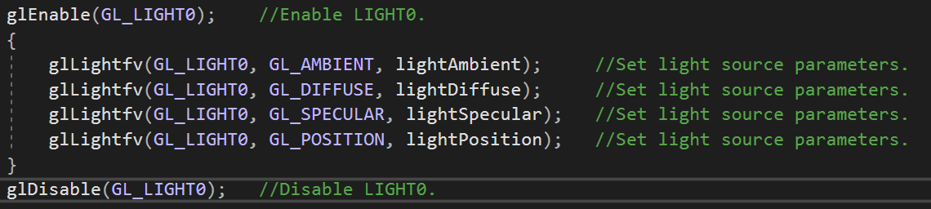
Light implementation
GL_LIGHT0 is a definition of the global light source implementation. I.e. type of light, position, color, attenuation, etc.

Slide 9
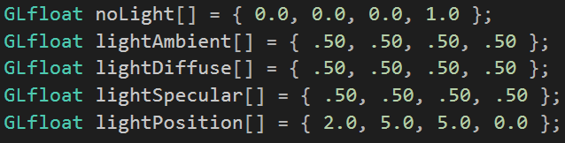
Lighting arrays
These are the parameters used for the glLight() command in the next slide. These arrays set the intensity of the light that will be generated.

Slide 10

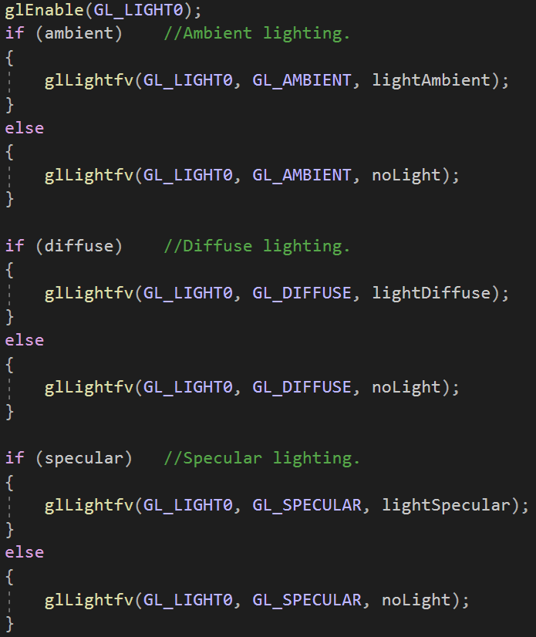
Lighting
This is how the lights are set within the scene.
glLight sets the light source parameters.

Slide 11
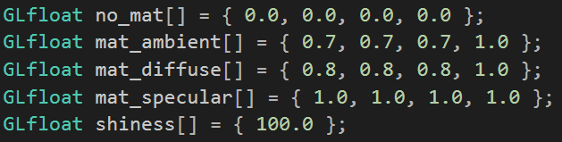
Lighting arrays cont.
These are the parameters used for the glMaterial() command in the next slide. These arrays set the intensity of the light that will be generated on the object itself.

Slide 12
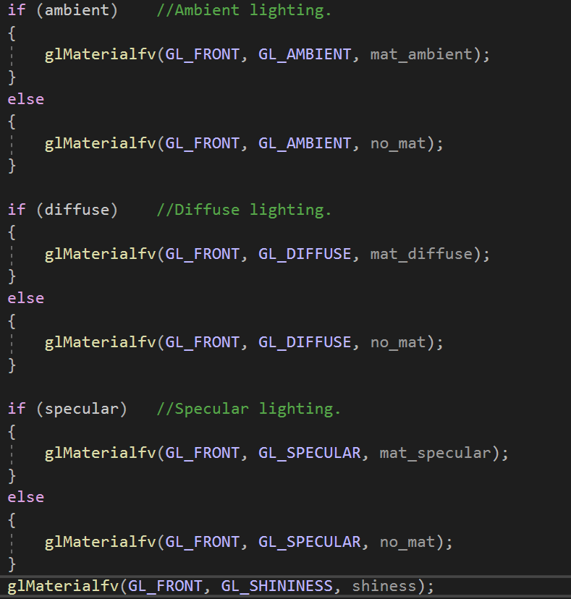
Lighting cont.
This is how the lights are set for the object that is being lit.
glMaterial specifies the material parameters for the lighting model.

Slide 13
Program Example

Slide 14


